Slide 1

Óbuda University
Óbuda University
Pro Sciencia et Futuro
Notes:
1

Slide 2
Faculties, education, research
Innovation and student life
Facts, figures, history

Slide 3
Hungarian Higher Educational Institutions
 | University | College/ Polytechnic | Total
Public | 26 | 3 | 29
Private | 4 | 7 | 11
Church | 5 | 21 | 26
Total | 35 | 31 | 66

Slide 4
Óbuda University in Hungary
 | University | Freshmen
1. | Eötvös Lóránd University | 8278
2. | University of Debrecen | 6278
3. | University of Szeged | 6234
4. | Budapest Business School | 5567
5. | Budapest University of Technology and Economics | 5246
6. | University of Pécs | 4856
7. | Szent István University | 3398
8. | Széchenyi István University | 3352
9. | Corvinus University of Budapest | 3295
10. | Óbuda University | 3075

Slide 5
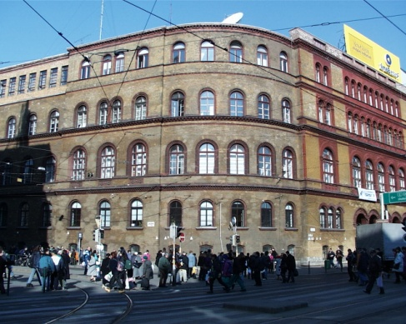
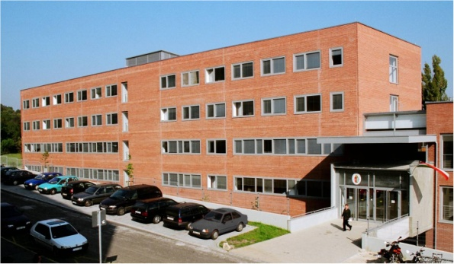
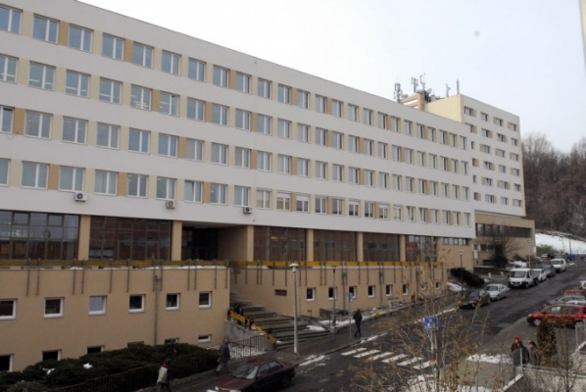
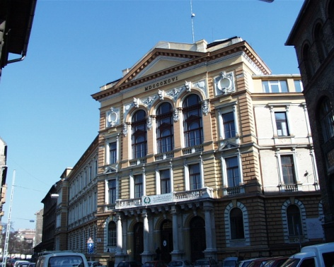
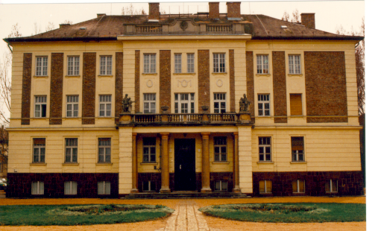
Campuses
Budapest
Óbuda
Budapest
Józsefváros
Székesfehérvár

Slide 6

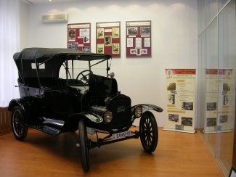

Brief History
Technical College of Light Industry
The Hungarian Royal Public Training School of Mechanics and Watchmaking(1888)
Kandó Kálmán
Polytechnic
Public Secondary Industrial School of Budapest (1879)
Bánki Donát Polytechnic
Budapest Tech
(2000)
Óbuda University
(2010)
Public Secondary Industrial School
Joseph A. GALAMB 1898-1901
Chief designer of the Ford Model T car

Slide 7
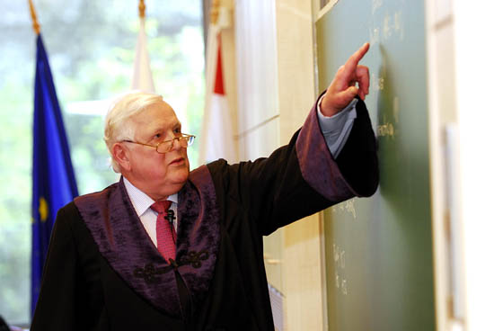
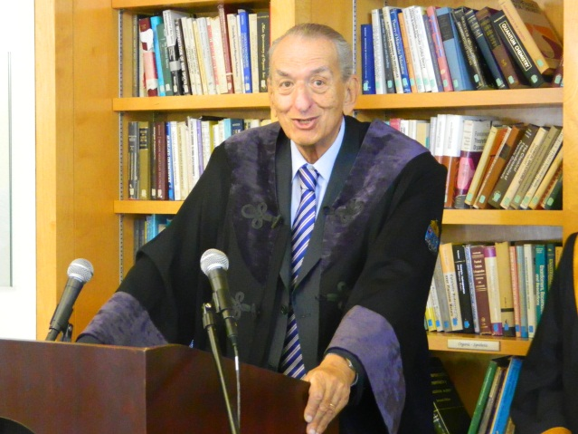
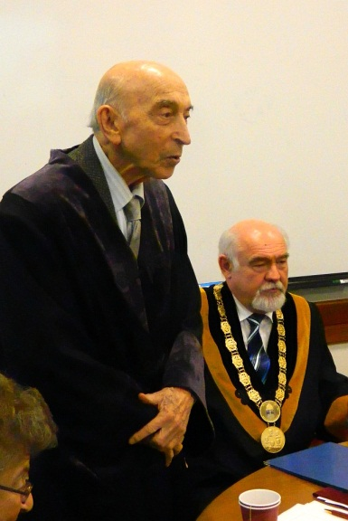
Honorary Doctors of Óbuda University
Dr. Rudolf KALMAN
electrical engineer at ETH Zürich and University of Florida (Kálmán-filter)
Dr. George A. OLAH
Nobel-laureate chemist at the University of Southern California
Dr. Lotfi A. ZADEH
mathematician-engineer at UC Berkeley (Fuzzy Logic)

Slide 8
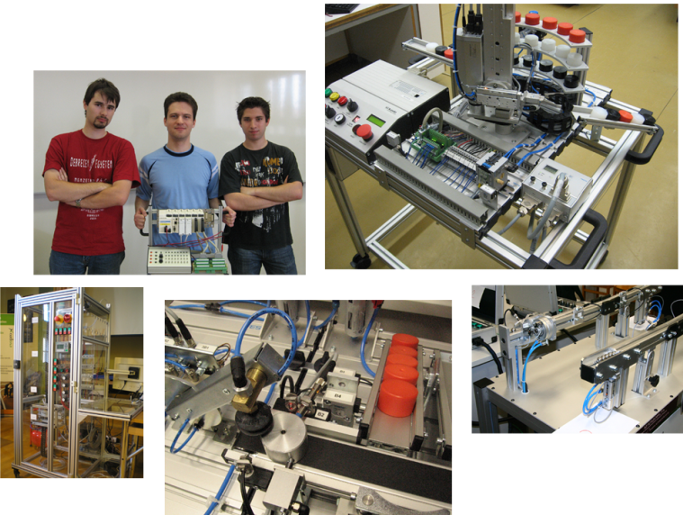
Campus 21
Institutional Development Plan
IDP
  Focus on
  traditions – development,
  networking,
  innovative teaching methods,
  practice oriented, close connection to enterprises,
  high quality BSc, MSc and PhD courses,
  internationally recognised R&D and innovation.

Slide 9
Faculties
Óbuda University
Alba Regia Technical Faculty
Bánki Donát Faculty of Mechanical and Safety Engineering
Kandó Kálmán Faculty of Electrical Engineering
Keleti Károly Faculty of Business and Management
John von Neumann Faculty of Informatics
Rejtő Sándor Faculty of Light Industry and Environmental Protection Engineering
Trefort Ágoston
Center of Teachers Training and Engineering Education

Slide 10
Óbuda University
More than 13000 Students
BSc programs
MSc programs
PhD Schools
Engineering
Engineering
Economics
Teacher Training
Applied Mathematics
Applied Informatics and Mathematics
Informatics
Economics
Safety and Security Sciences
Material Sciences and Technologies
Informatics
250 foreign students
14 basic courses
7 in English
10 master courses
3 in English
3 PhD programs

Slide 11
BSc degree
PhD
MSc degree
Gépészmérnöki szak
Had- és biztonság-technikai mérnöki szak
Mechatronikai mérnöki szak
Műszaki szakoktató szak
Villamosmér-nöki szak
Gazdálkodási és menedzsment szak
Mérnök informatikus szak
Könnyűipari mérnöki szak
Környezetmér-nöki szak
Ipari termék- és formatervezői szak
Kereskedelem és marketing szak
Műszaki menedzser szak
Villamosmér-nöki szak angol nyelven
Mechanical Engineering
Military and Safety Technology
Mechatronic engineering
Technical Teacher Training
Electrical engineering
Management and Business Administration
Computer Engineering
Light Industry Engineering
Environmental Engineering
Industrial Design Engineering
Commerce and Marketing
Technical Management
Land Surveying and Land Management Engineer
Enterprise Management
Computer Engineering
Light Industry Engineering
Mechatronical Engineering
Security Technology Engineering
Electrical Engineering
Applied Mathematics
Engineering Teaching
Doctoral School of Applied Informatics and Applied Mathematics
Doctoral School on Safety and Security Sciences
Doctoral School on Material Sciences and Technologies

Slide 12
Science and Research
University Research and Innovation
10 Knowledge Centres
10-12 International Conferences or Symposia organised by ÓU
Participation in more than 20 scientific projects of EU

Slide 13


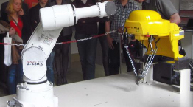

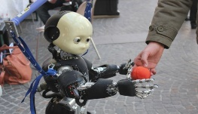
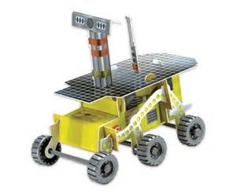
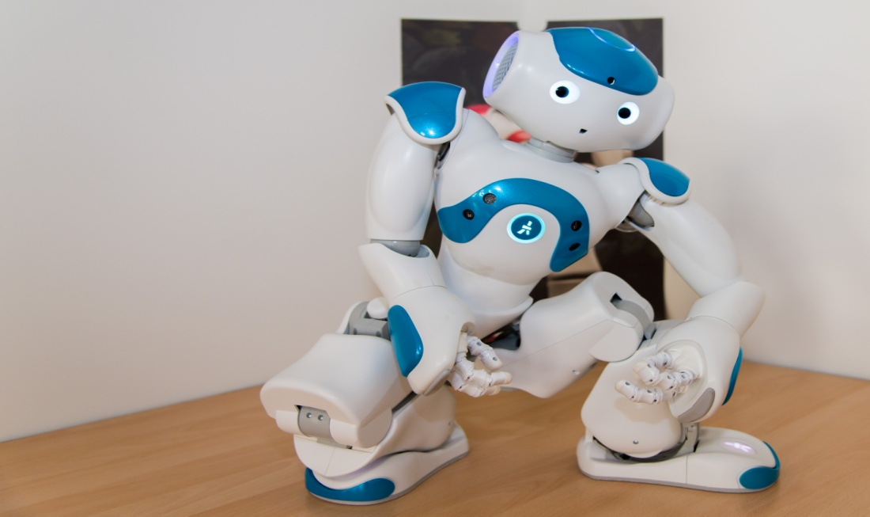
Knowledge Centres
Antal Bejczy Centre for Intelligent Robotics
Bio-Tech Knowledge Centre
K-MOOC (Online Education Center)
SMART LAB
Physiological Controls Group
Alternative Energy Resourses Knowledge Center
Digital Knowledge Center for Culture and Human Technology
Knowledge Center for Security Studies
Organizational Science Group
Electric Drive System Knowlegde Center

Slide 14
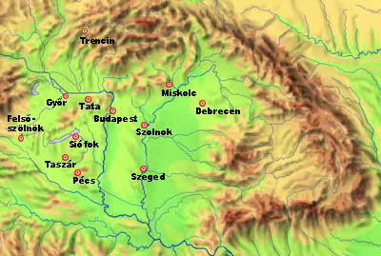
Conferences
Conferences
INES
(all over the WORD)
SAMI (SK)
CINTI (HU)
SACI (RO)
SISY (SR)

Slide 15
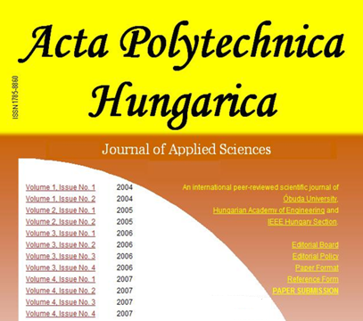
http://uni-obuda.hu/journal/

Slide 16
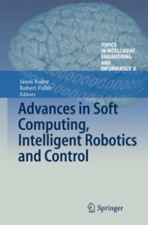








9 volumes from 2012

Slide 17
International Relations
- more than 40 countries.
- more than 200 foreign universities and centres
177 scientific cooperations
117 agreements related to education
128 mobility contracts

Slide 18
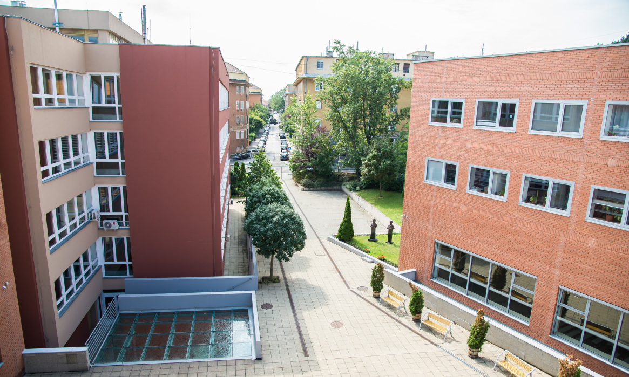
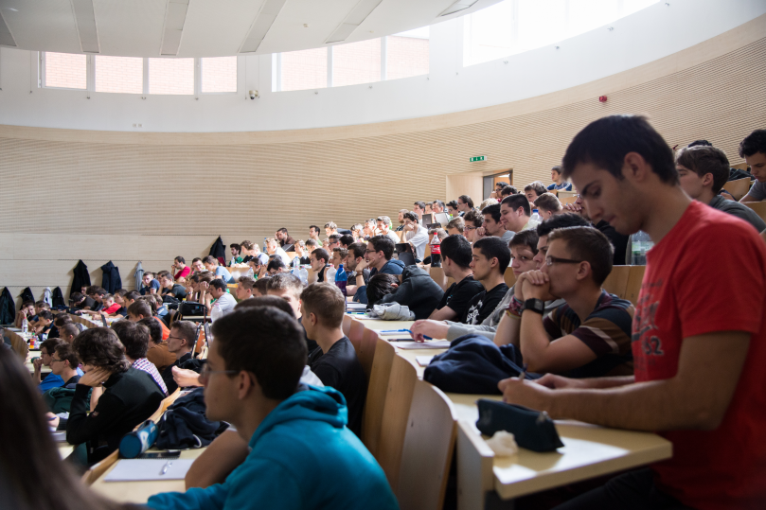
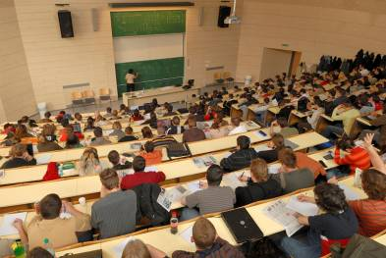
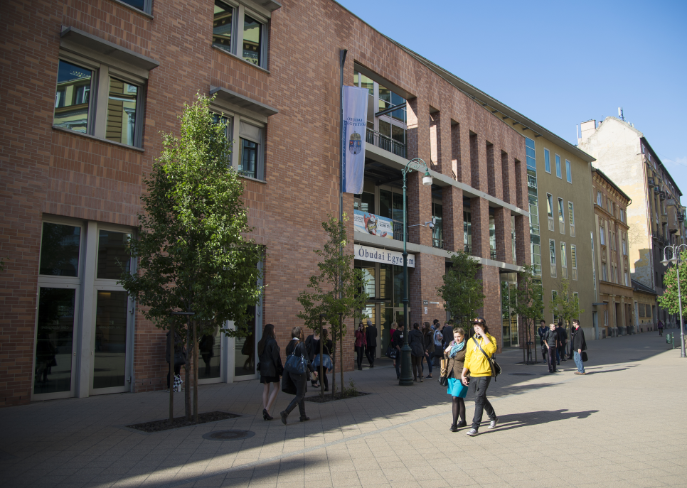
Infrastructure development

Slide 19













Industrial relationships
More than 40 relations

Slide 20
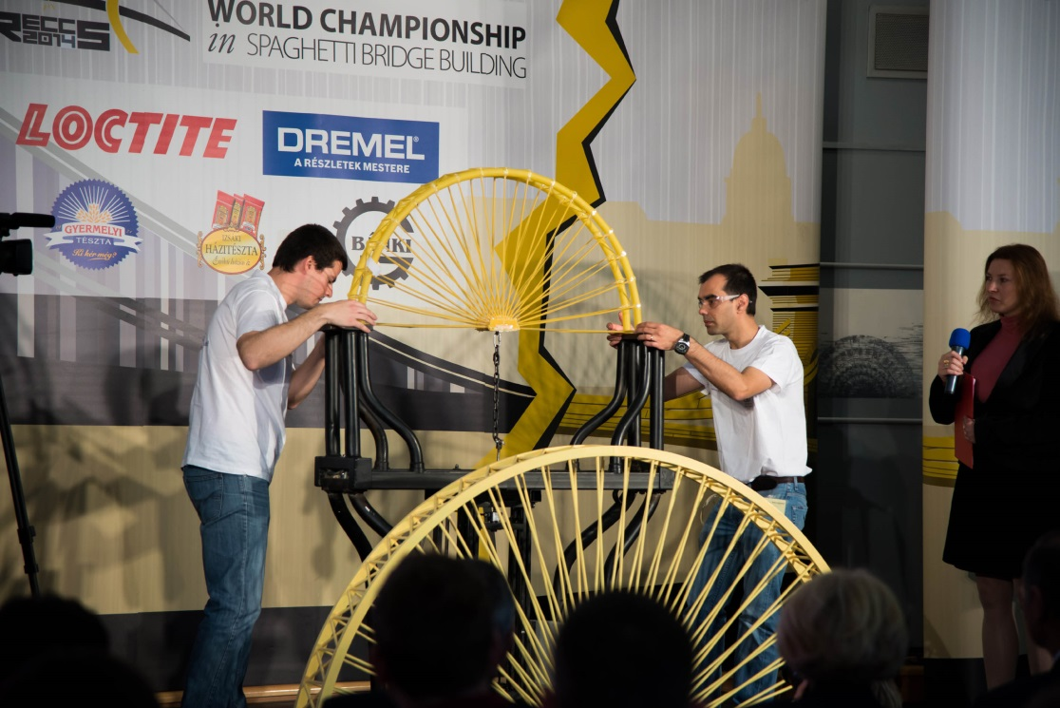
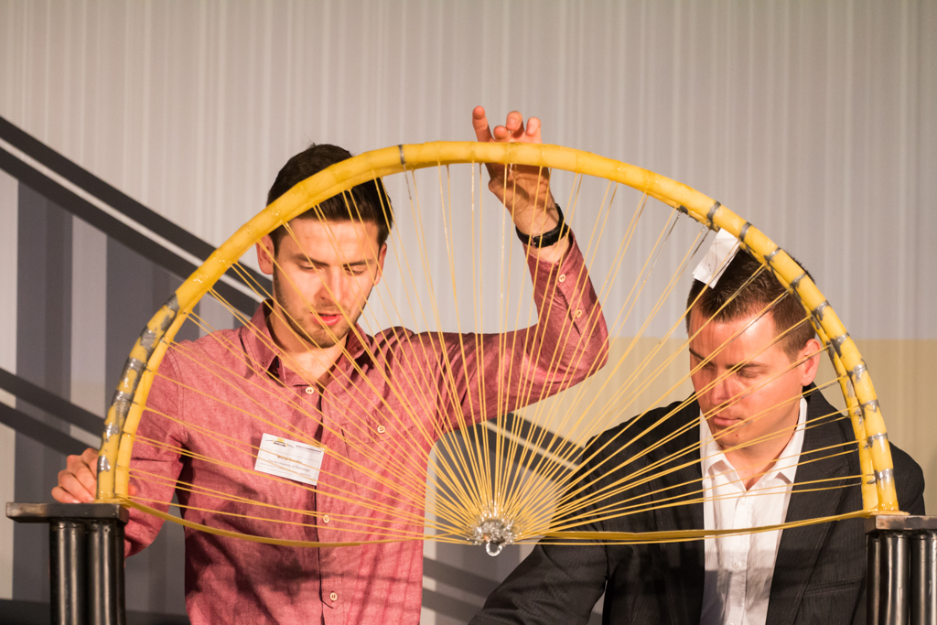
Student innovation
The rules:
1 kg spaghetti (from the cornershop)
Normal glue (also from the cornershop)
The bridge must be 1 meter wide
Pulled in the midle width weight until is broken
Guess, at how many kilogramms the bridge will break?
611,8 Kg
Spaghetti-Bridge Building
World Competition
World Champion
OU student
Mr. Szilard MARKOS
New world record:

Slide 21
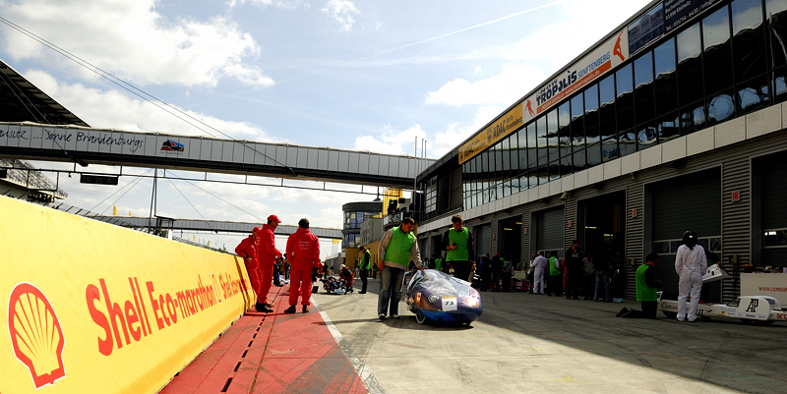
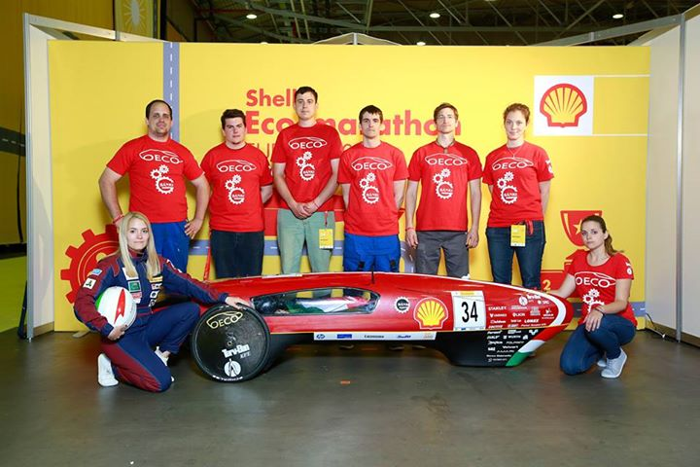
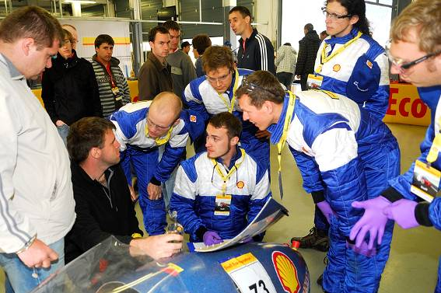
Student innovation
The challenge is to run as many kilometers as you can with only 1 liter of petrol in the tank!
Guess, how many kilometers this car can run with 1 liter of petrol!
565,5 Km
Shell Eco-marathon

Slide 22
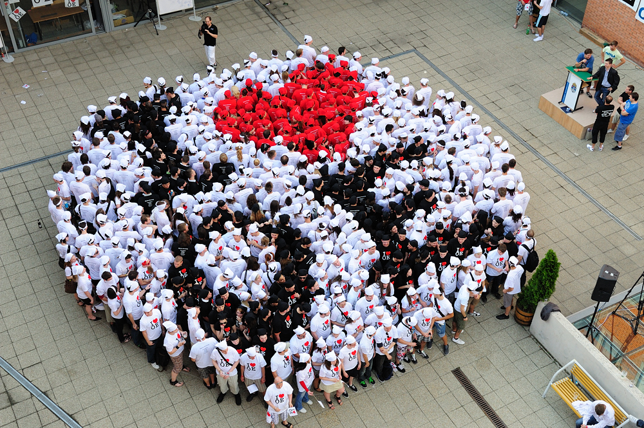
Vibrant student life at ÓU

Slide 23
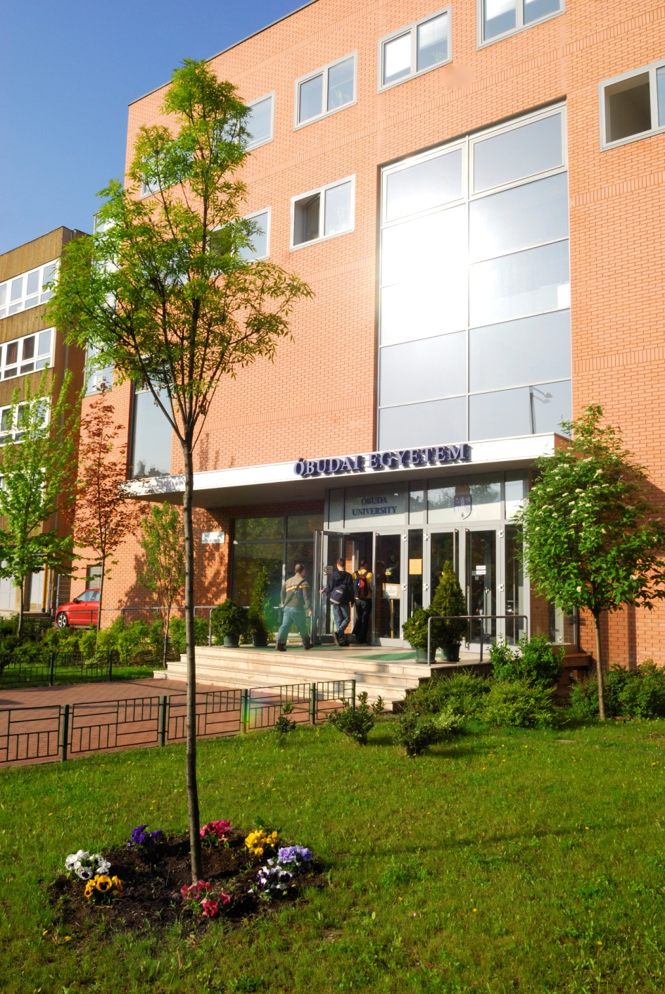

Thank you for your attention!

